Slide 1
Activation Record

Slide 2
Activation Record
An activation record is a contiguous block of storage that manages information required by a single execution of a procedure.
When you enter a procedure, you allocate an activation record, and when you exit that procedure, you de-allocate it.
Basically, it stores the status of the current activation function.
So, whenever a function call occurs, then a new activation record is created and it will be pushed onto the top of the stack. It will remain in stack till the execution of that function.
So, once the procedure is completed and it is returned to the calling function, this activation function will be popped out of the stack.
If a procedure is called, an activation record is pushed into the stack, and it is popped when the control returns to the calling function.

Slide 3
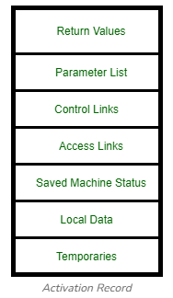
Contd.
Temporaries:
The temporary values, such as those arising in the evaluation of expressions, are stored in the field for temporaries.
Local data:
The field for local data holds data that is local to an execution of a procedure.
Saved Machine States:
The field for Saved Machine Status holds information about the state of the machine just before the procedure is called. This information includes the value of the program counter and machine registers that have to be restored when control returns from the procedure.

Slide 4
Contd.
Access Link : It refers to information stored in other activation records that is non-local. The access link is a static link and the main purpose of the access link is to access the data which is not present in the local scope of the activation record.
As a chain of access links (think of scopes), the program traces its static structure.

Slide 5
Contd.
Control Links : In this case, it refers to an activation record of the caller. They are generally used for links and saved status.
It is a dynamic link in nature. When a function calls another function, then the control link points to the activation record of the caller.

Slide 6
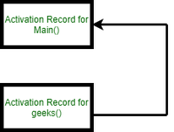
Contd.
#include<stdio.h>
int geeks(int x)
{
printf("value of x is: %d", x);
}
int main()
{
geeks(10);
}

Slide 7
Contd.
Parameter List (Actual Parameter):
The field for parameters list is used by the calling procedure to supply parameters to the called procedure. We show space for parameters in the activation record, but in practice, parameters are often passed in machine registers for greater efficiency.
Return value:
The field for the return value is used by the called procedure to return a value to the calling procedure. Again in practice, this value is often returned in a register for greater efficiency.

Slide 8
Reference
Activation Records - GeeksforGeeks

